Slide 1
Types of DBMS Architecture
There are several types of DBMS Architecture that we use according to the usage requirements.
1-Tier Architecture
2-Tier Architecture
3-Tier Architecture

Slide 2
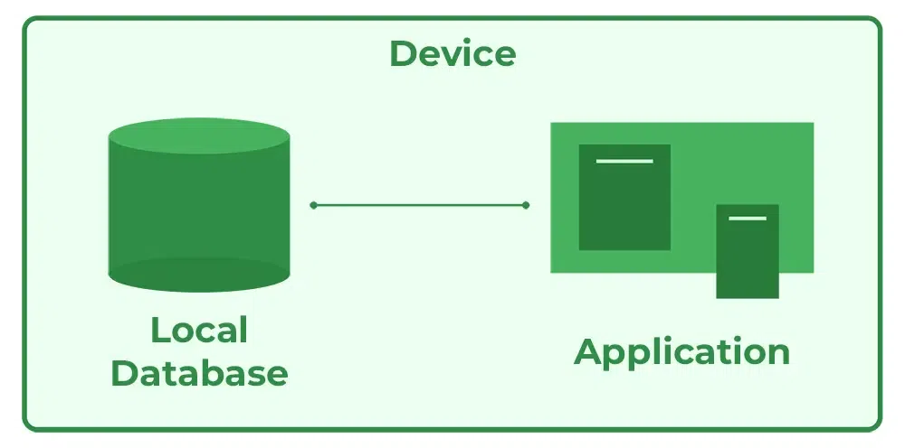
1-Tier Architecture

Slide 3
Advantages of 1-Tier Architecture
Simple Architecture: 1-Tier Architecture is the most simple architecture to set up, as only a single machine is required to maintain it.
Cost-Effective: No additional hardware is required for implementing 1-Tier Architecture, which makes it cost-effective.
Easy to Implement: 1-Tier Architecture can be easily deployed and hence it is mostly used in small projects.

Slide 4
Disadvantages of 1-Tier Architecture
Limited to Single User: Only one person can use the application at a time. It’s not designed for multiple users or teamwork.
Poor Security: Since everything is on the same machine, if someone gets access to the system, they can access both the data and the application easily.
No Centralized Control: Data is stored locally, so there's no central database. This makes it hard to manage or back up data across multiple devices.
Hard to Share Data: Sharing data between users is difficult because everything is stored on one computer.

Slide 5
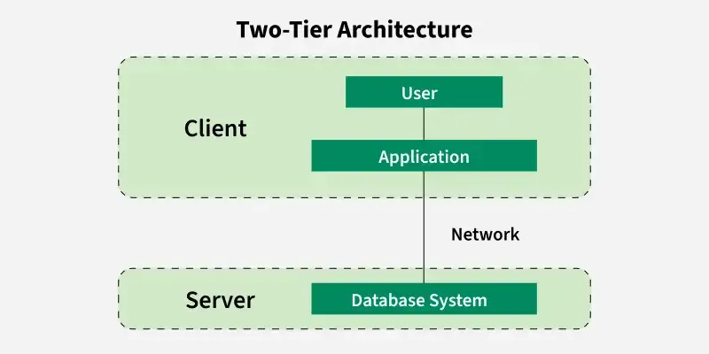
2-Tier Architecture

Slide 6
Advantages of 2-Tier Architecture
Easy to Access: 2-Tier Architecture makes easy access to the database, which makes fast retrieval.
Scalable: We can scale the database easily, by adding clients or upgrading hardware.
Low Cost: 2-Tier Architecture is cheaper than 3-Tier Architecture and Multi-Tier Architecture.
Easy Deployment: 2-Tier Architecture is easier to deploy than 3-Tier Architecture.
Simple: 2-Tier Architecture is easily understandable as well as simple because of only two components.

Slide 7
Disadvantages of 2-Tier Architecture
Limited Scalability: As the number of users increases, the system performance can slow down because the server gets overloaded with too many requests.
Security Issues: Clients connect directly to the database, which can make the system more vulnerable to attacks or data leaks.
Tight Coupling: The client and the server are closely linked. If the database changes, the client application often needs to be updated too.
Difficult Maintenance: Managing updates, fixing bugs, or adding features becomes harder when the number of users or systems increases.

Slide 8
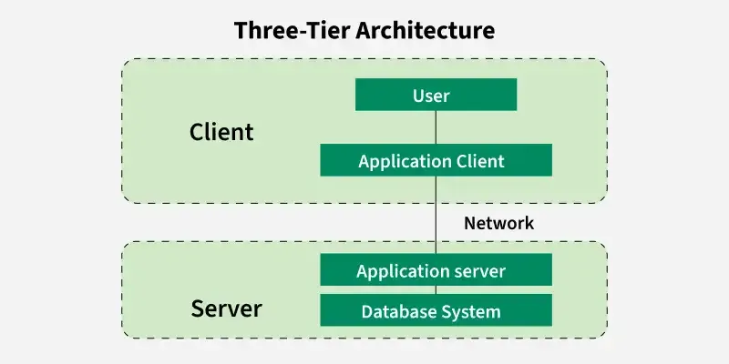
3-Tier Architecture

Slide 9
Advantages of 3-Tier Architecture
Enhanced scalability: Scalability is enhanced due to the distributed deployment of application servers. Now, individual connections need not be made between the client and server.
Data Integrity: 3-Tier Architecture maintains Data Integrity. Since there is a middle layer between the client and the server, data corruption can be avoided/removed.
Security: 3-Tier Architecture Improves Security. This type of model prevents direct interaction of the client with the server thereby reducing access to unauthorized data.

Slide 10
Disadvantages of 3-Tier Architecture
More Complex: 3-Tier Architecture is more complex in comparison to 2-Tier Architecture. Communication Points are also doubled in 3-Tier Architecture.
Difficult to Interact: It becomes difficult for this sort of interaction to take place due to the presence of middle layers.
Slower Response Time: Since the request passes through an extra layer (application server), it may take more time to get a response compared to 2-Tier systems.
Higher Cost: Setting up and maintaining three separate layers (client, server and database) requires more hardware, software and skilled people. This makes it more expensive.

Slide 11
Introduction of ER Model
The Entity-Relationship Model (ER Model) is a conceptual model for designing a databases. This model represents the logical structure of a database, including entities, their attributes and relationships between them.
Entity: An objects that is stored as data such as Student, Course or Company.
Attribute: Properties that describes an entity such as StudentID, CourseName, or EmployeeEmail.
Relationship: A connection between entities such as "a Student enrolls in a Course".

Slide 12
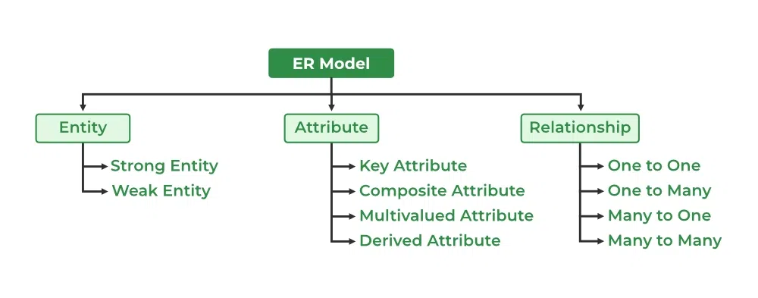

Slide 13
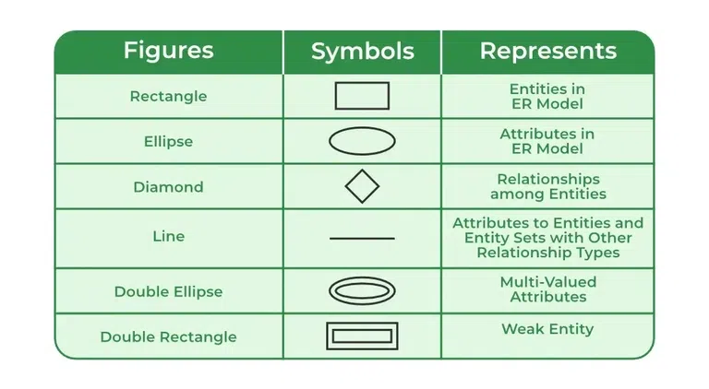
Symbols Used in E-R Model

Slide 14
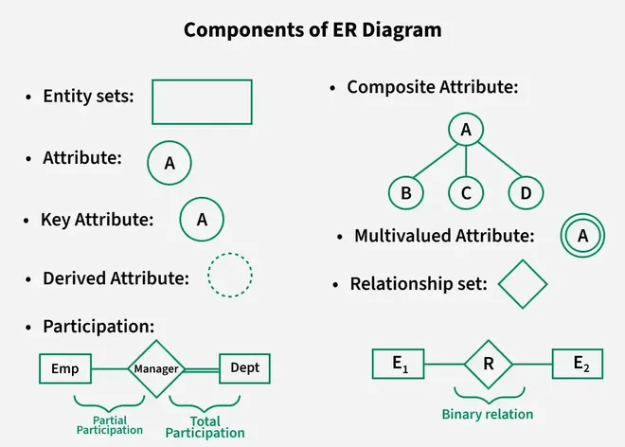
Components of E-R Diagram

Slide 15
What is an Entity?
An Entity represents a real-world object, concept or thing about which data is stored in a database. It act as a building block of a database. Tables in relational database represent these entities.
Example of entities:
Real-World Objects: Person, Car, Employee etc.
Concepts: Course, Event, Reservation etc.
Things: Product, Document, Device etc.
The entity type defines the structure of an entity, while individual instances of that type represent specific entities.

Slide 16
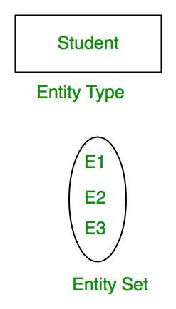
Entity and Entity Set
What is an Entity Set?
An entity refers to an individual object of an entity type, and the collection of all entities of a particular type is called an entity set. For example, E1 is an entity that belongs to the entity type "Student," and the group of all students forms the entity set.

Slide 17
Types of Entity
There are two main types of entities:
Strong Entity
A Strong Entity is a type of entity that has a key Attribute that can uniquely identify each instance of the entity. A Strong Entity does not depend on any other Entity in the Schema for its identification. It has a primary key that ensures its uniqueness and is represented by a rectangle in an ER diagram.
Weak Entity
A Weak Entity cannot be uniquely identified by its own attributes alone. It depends on a strong entity to be identified. A weak entity is associated with an identifying entity (strong entity), which helps in its identification. A weak entity are represented by a double rectangle. The participation of weak entity types is always total. The relationship between the weak entity type and its identifying strong entity type is called identifying relationship and it is represented by a double diamond.

Slide 18
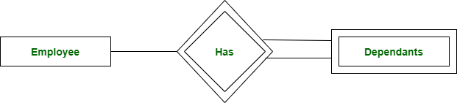
Strong Entity and Weak Entity
A company may store the information of dependents (Parents, Children, Spouse) of an Employee. But the dependents can't exist without the employee. So dependent will be a Weak Entity Type and Employee will be identifying entity type for dependent, which means it is Strong Entity Type.

Slide 19
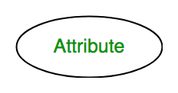
Attributes in ER Model
Attributes are the properties that define the entity type. For example, for a Student entity Roll_No, Name, DOB, Age, Address, and Mobile_No are the attributes that define entity type Student. In ER diagram, the attribute is represented by an oval.

Slide 20
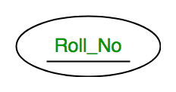
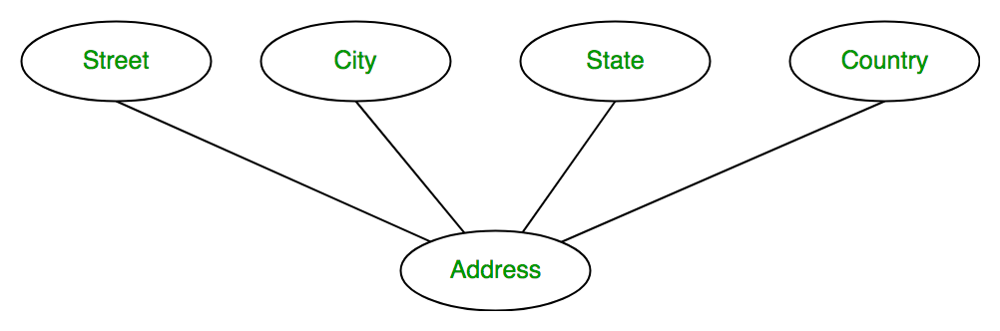
Types of Attributes
Key Attribute
The attribute which uniquely identifies each entity in the entity set is called the key attribute. For example, Roll_No will be unique for each student. In ER diagram, the key attribute is represented by an oval with an underline.
Composite Attribute
An attribute composed of many other attributes is called a composite attribute. For example, the Address attribute of the student Entity type consists of Street, City, State, and Country. In ER diagram, the composite attribute is represented by an oval comprising of ovals.

Slide 21
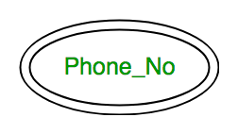
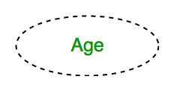
Multivalued Attribute
An attribute consisting of more than one value for a given entity. For example, Phone_No (can be more than one for a given student). In ER diagram, a multivalued attribute is represented by a double oval.
Derived Attribute
An attribute that can be derived from other attributes of the entity type is known as a derived attribute. e.g.; Age (can be derived from DOB). In ER diagram, the derived attribute is represented by a dashed oval.

Slide 22
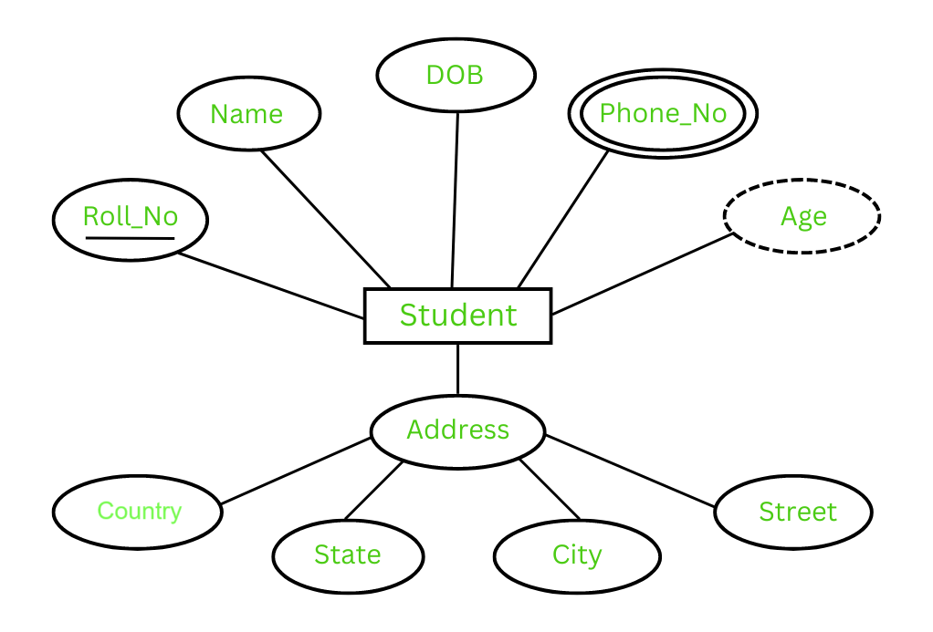
Complete Entity Type with its Attributes

Slide 23
Cardinality in DBMS
Cardinality of relation expresses the maximum number of possible relationship occurrences for an entity participating in a relationship. Cardinality of a relationship can be defined as the number of times an entity of an entity set participates in a relationship set. Let's suppose a binary relationship R between two entity sets A and B. The relationship must have one of the following mapping cardinalities:
One-to-One: When one entity of A is related to at most one entity of B, and vice-versa.
One-to-Many: When one entity of A is related to one or more than one entity of B. Whereas B is associated with at most one entity in A.
Many-to-One: When one entity of B is related to one or more than one entity of A. Whereas A is associated with at most one entity in B.
Many-to-Many: Any number of entities of A is related to any number of entities of B, and vice-versa.

Slide 24
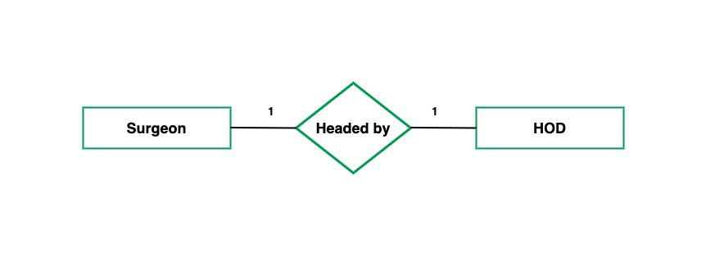
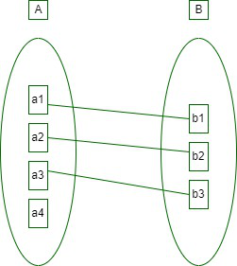

Slide 25
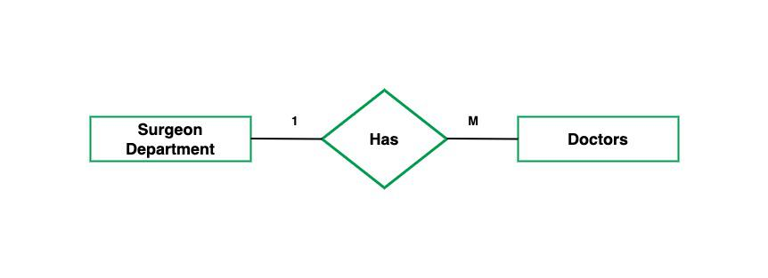
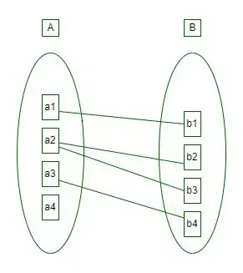

Slide 26
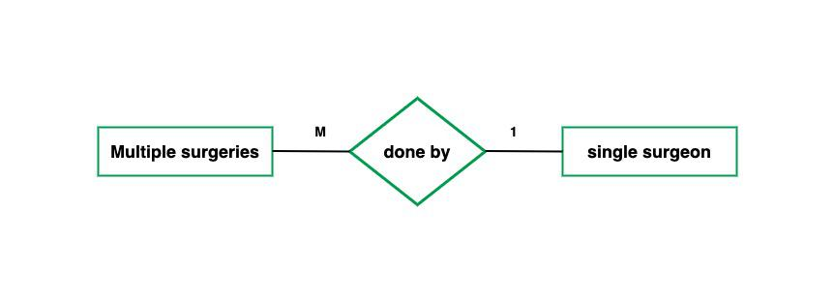
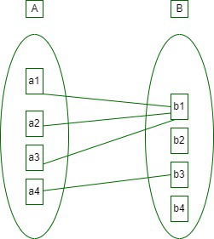

Slide 27
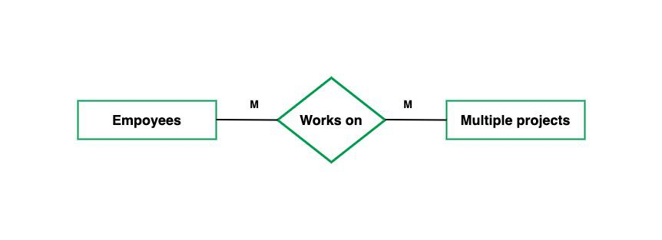
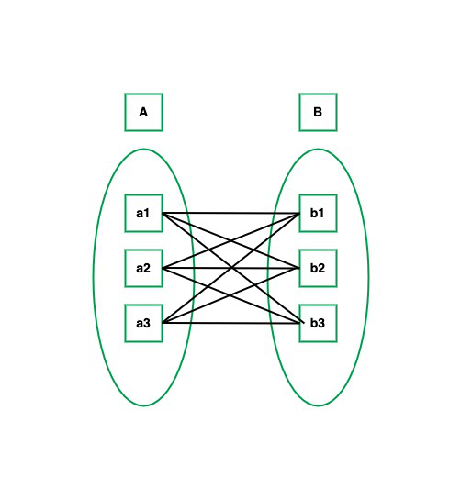

Slide 28
THANK YOU

